Slide 1
GROUP 2
RESISTORS
NAME | REG.NO | STD.NO
NAKAWUNGU TEDDY | 23/U/13595/EVE | 2300713595
NAMATA HAULA MUANAISHA | 23/U/14394/EVE | 2300714394
NABBAALE CLAIRE | 23/U/12770/EVE | 2300712770
SUKWE BENJAMIN | 23/U/24518/EVE | 2300724518
TWESIGE TREJAN | 23/U/18302/EVE | 2300718302
KINATAMA LAUREN | 23/U/09869/EVE | 2300709869
MWESIGWA ELAINE
SSERUBE BERIS MARTIN
KISIRINYA SIRAJJE | 23/U/24072/EVE | 2300724072
ASINGWIRE ERIC HANNINGTON

Slide 2
WHAT IS A RESISTOR?
A resistor is a passive electrical component that is used for either limiting or regulating the flow of electrical current in an electrical circuit.

Slide 3

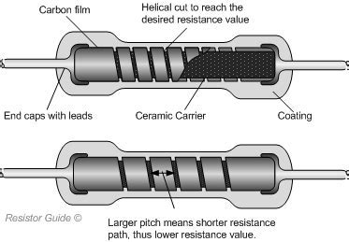
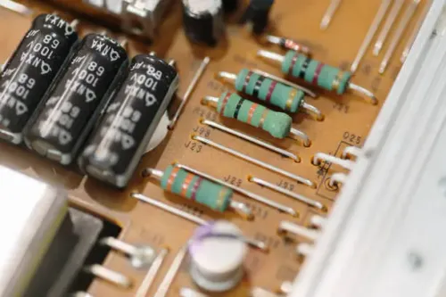
HOW A RESISTOR WORKS
For ohmic resistors;
From Ohm’s law, the higher the resistance, the lower the current flow.

Slide 4
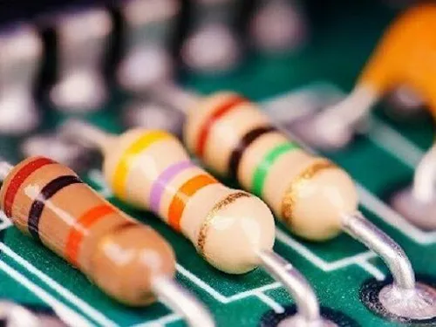
TYPES OF RESISTORS
FIXED RESISTORS
These resistors have a fixed value of resistance.
Examples include carbon film resistors, wire wound resistors, etc.

Slide 5
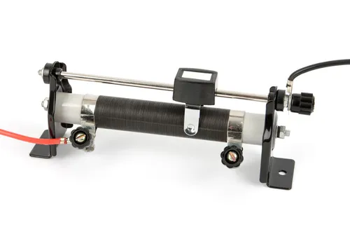
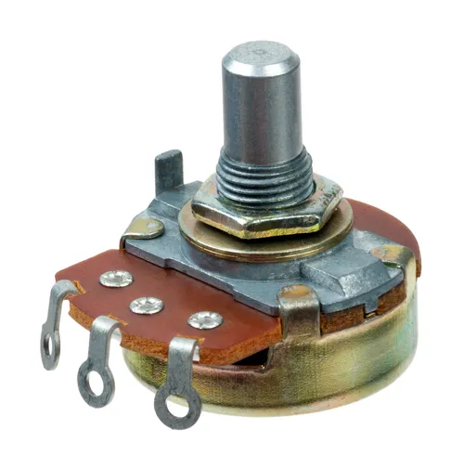
2. VARIABLE RESISTORS
These are resistors whose resistance values can be adjusted.
Examples include potentiometers and rheostats.

Slide 6
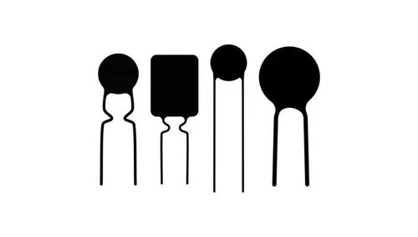
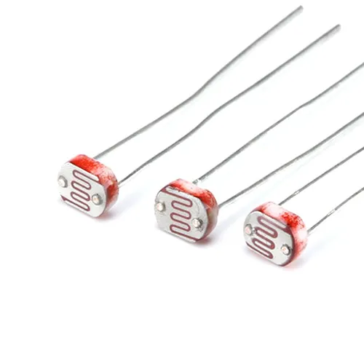
3. SPECIAL RESISTORS
These are unique property resistors used in specific applications, and are classified under;
Thermistors which are heat sensitive
Photoresistors which are light sensitive.

Slide 7
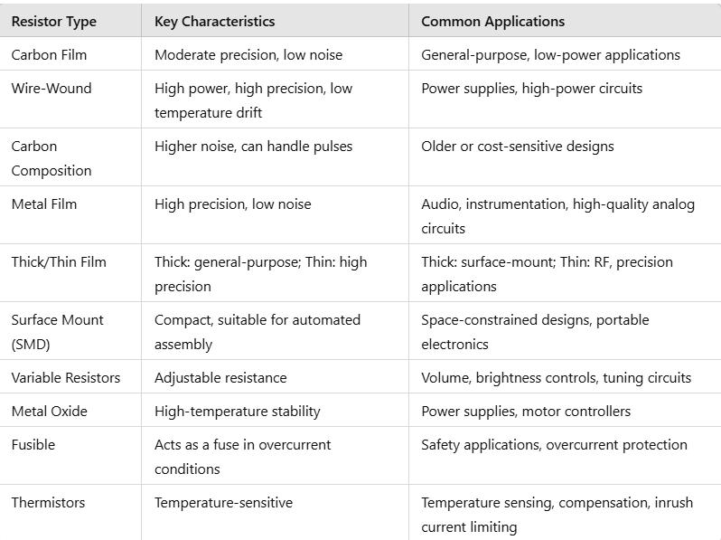

Slide 8
COMMON APPLICATIONS OF RESISTORS
Voltage Division. Often resistors are used in voltage divider circuits to create a desired voltage from a higher voltage supply.
Pull-up and Pull-down resistors are used to ensure that pins of microcontrollers and other digital logic devices have a known state when no active signal is present.
Protection of Analog Inputs Resistors are placed in series with analog input pins to limit the current in case of unexpected voltage spikes or excessive input voltages.
Example: When interfacing with external sensors, a resistor in series with the analog input pin helps protect the microcontroller's ADC from over-voltage, improving robustness.

Slide 9
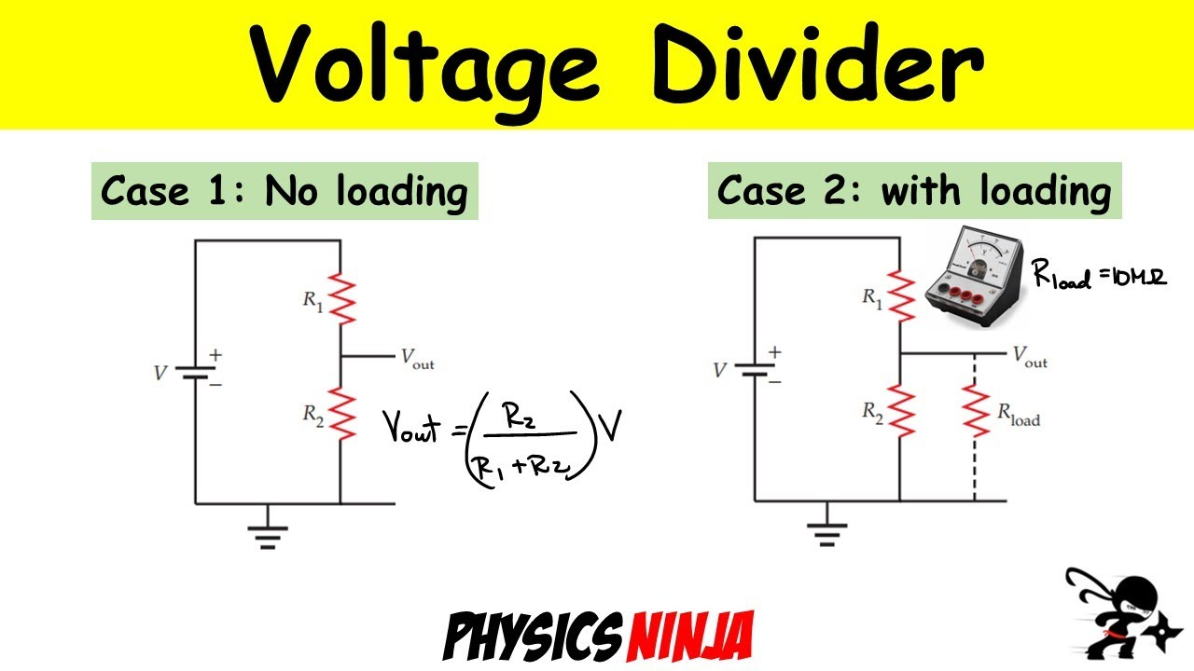
Voltage Division
Voltage dividers are used for adjusting the level of a signal, for bias of active devices in amplifiers, and for measurement of voltages
Example: In a 5V system, a voltage divider can step down the voltage to 3.3V for components like sensors or ADCs (Analog-to-Digital Converters) that only support lower voltage levels (Kirchoff’s).

Slide 10
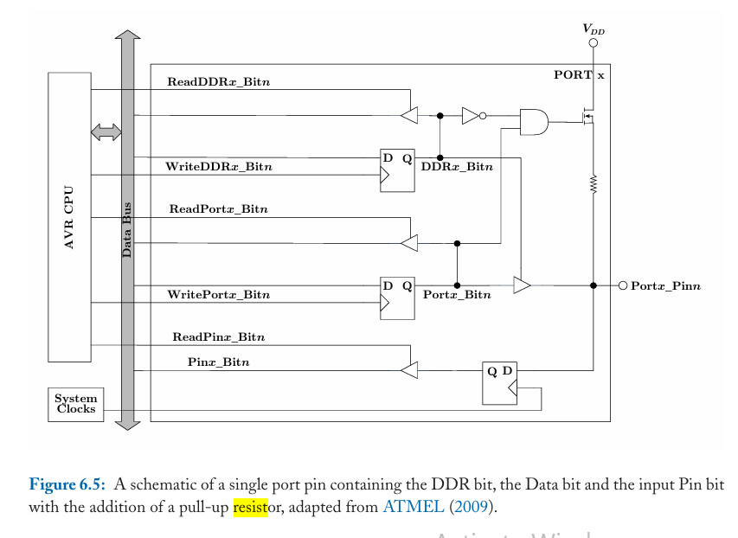
ILLUSTRATION OF INTERNAL PULL UP RESISTOR IN USE
Notes:
Generally, when a port pin is not being used, the microcontroller will default the pins to input, in order to save power. However,if the pin is unused,then it's probably not connected to an external circuitry. As a result, the input pin is floating, and the input signal to the Pinx_Bitn D flip-flop is unknown,which can lead to strange and unexpected behavior;for example, an unexpected/unwanted interrupt might occur.A very standard method for managing unused input pins is to connect a fairly large resistance between the pin and the power supply.In this way,the port pin is very weakly pulled high, and no unwanted transitions will occur. It turns out that because this method is so standard, most microprocessors will provide internal pull-up resistors on any port pins that may be configured as inputs. The ATmega328P provides internal pull-up resistors on all port pins, which can be enabled and disabled based on the schematic depicted in Fig. 6.5.
New to the schematic is an AND gate that has inputs of the DDRx_Bitn (Data Direction Register) output via an inversion and the Portx_Bitn output.The output of the AND gate goes to the gate of a transistor, which then allows a channel pathway between the power supply and the pin perhaps through a resistor, although the transistor can be made to act as the resistor itself. As a result, an internal pull-up behavior is enabled via the following procedure:
1. write a ‘0’ into DDRx_Bitn, then
2. write a ‘1’ into Portx_Bitn.
To keep a portpin configured as an input, but to disable the internal pull-up, a ‘0’ would be written into Portx_Bitn instead.
Note that this procedure is very specific to the ATmega328P microcontroller; other processors offer their own methods for managing internal pull-up resistors
In this schematic, the pull-up resistor is connected between the power supply \( V_{DD} \) and the output pin (Portx\_Pinn). Here’s how it works:
In summary, the pull-up resistor ensures a stable high state on Portx\_Pinn when the output is not actively pulled low by the transistor, providing a reliable logic level and preventing floating states in both input and output configurations.
Summary
: The pull-up resistor ensures that the pin Portx\_Pinn is in a defined state (logic high, or close to \( V_{DD} \)) when the output transistor connected to ground (open-drain or open-collector configuration) is off (not conducting). Without a pull-up resistor, the pin could float, resulting in an undefined or noisy state.
2. **Operation in Output Mode**:
- When the DDRx\_Bitn (Data Direction Register bit) is set, the Portx\_Bitn controls the output state.
- If Portx\_Bitn is high, the transistor is off, and the pull-up resistor pulls Portx\_Pinn to \( V_{DD} \), giving a high output.
- If Portx\_Bitn is low, the transistor turns on, connecting Portx\_Pinn to ground, resulting in a low output.
3. **Operation in Input Mode**:
- When DDRx\_Bitn is cleared, the pin operates in input mode.
- The pull-up resistor can be optionally enabled (if implemented) to pull the input pin to a high state, avoiding floating.
- The ReadPinx\_Bitn signal allows reading the actual state of the pin, taking the pull-up resistor’s effect into account.

